Slide 1
8
Stock Valuation

Slide 2

Chapter 8 – Index of Sample Problems
Slide # 02 - 07 Zero growth stock
Slide # 08 - 17 Constant growth stock
Slide # 18 - 23 Irregular growth stock
Slide # 24 - 29 Required return
Slide # 30 - 37 Preferred stock
Slide # 38 - 41 Shareholder voting
Slide # 42 - 43 Stock market reporting

Slide 3
2: Zero growth stock
Rainbow Rentals pays a constant annual dividend of $1.00 per share on their common stock.
How much are you willing to pay for one share of this stock if you want to earn a 9% rate of return?

Slide 4
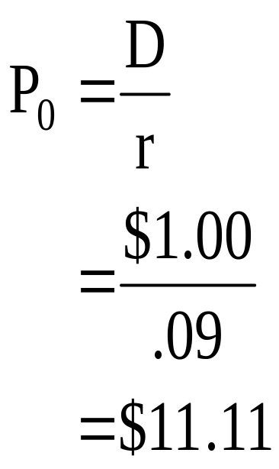
3: Zero growth stock

Slide 5
4: Zero growth stock
Bits ‘n Pieces pays a constant annual dividend of $.50 a share. The market price of the stock is $5.41 today.
What is the rate of return on this stock?

Slide 6
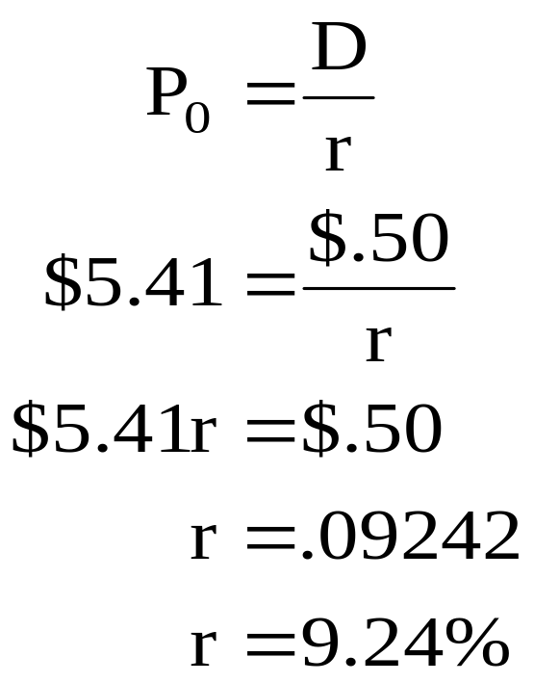
5: Zero growth stock

Slide 7
6: Zero growth stock
The common stock of Kathy’s Antiques, Etc. is priced at $12.50 a share. The stock provides a 10% rate of return. The company pays a constant dividend.
What is the amount of the annual dividend?

Slide 8
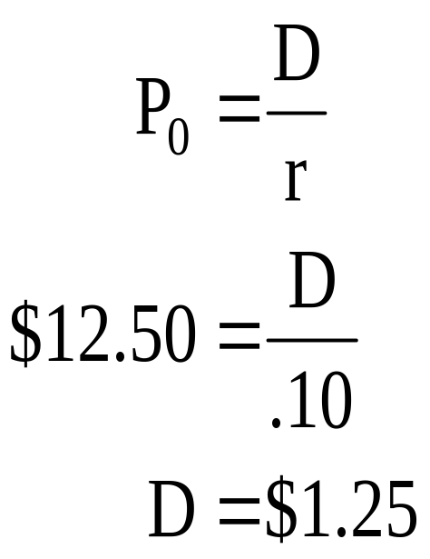
7: Zero growth stock

Slide 9
8: Constant growth stock
JLE, Inc. just paid their annual dividend of $1.10 a share. JLE’s policy is to increase the dividend by 2% annually.
How much are you willing to pay today for a share of this stock if you require an 11% rate of return?

Slide 10
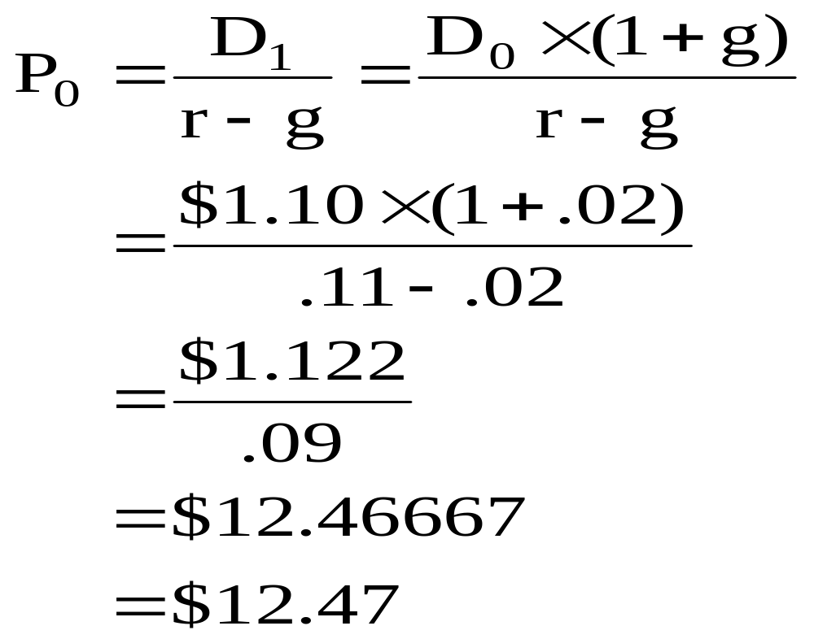
9: Constant growth stock

Slide 11
10: Constant growth stock
SLG, Inc. announced today that they will be increasing their annual dividend to $1.60 per share next year. After that, they expect to increase the dividend by 3% annually. You want to buy shares of stock in this company but can not afford to do so for another two years. At that time, you will buy shares if you can earn a 12% rate of return.
How much will you be willing to pay for one share of this stock two years from today?

Slide 12
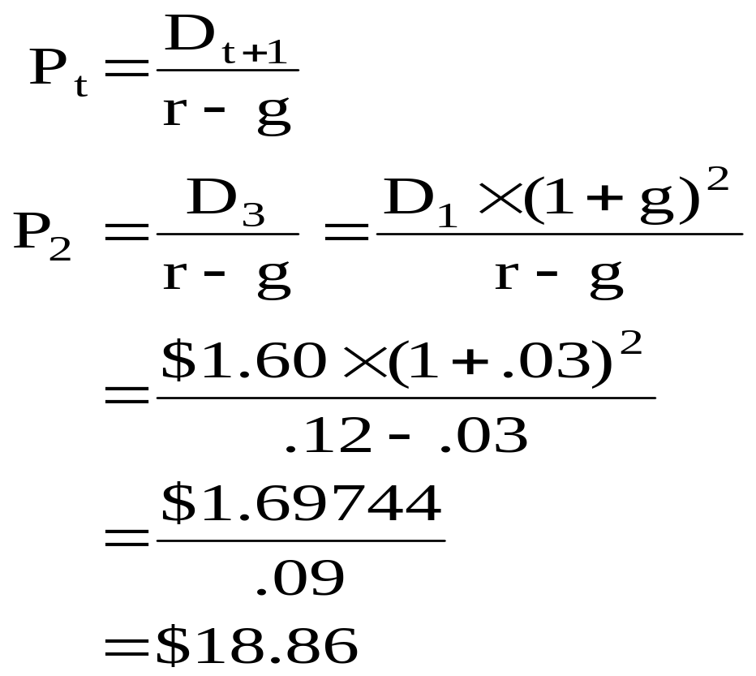
11: Constant growth stock

Slide 13
12: Constant growth stock
Alex’s Ventures, Inc. stock has a 13% rate of return and a current market price of $16.18. The company pays annual dividends. The last dividend paid was $1.40 per share.
What is the growth rate of this stock?

Slide 14
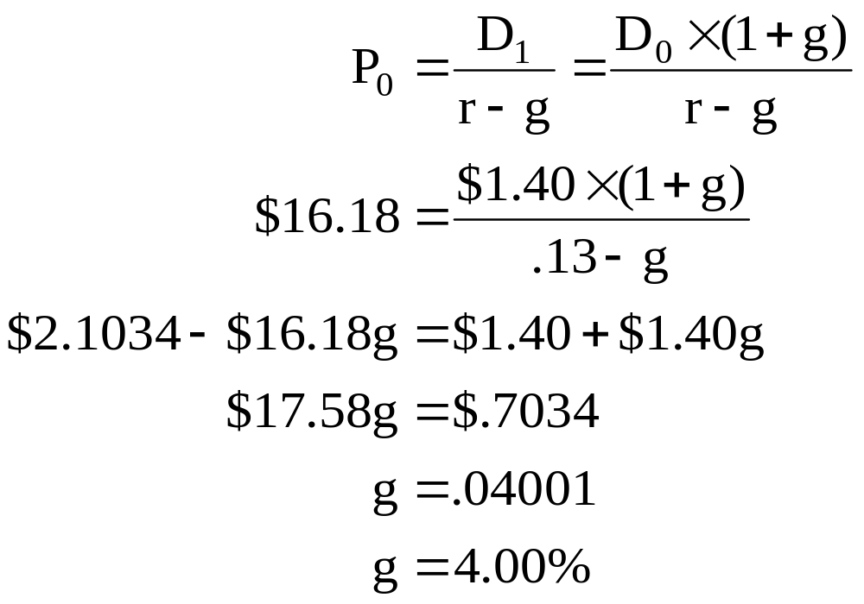
13: Constant growth stock

Slide 15
14: Constant growth stock
C and F Fabrics is going to pay an annual dividend of $1.36 per share next week. The dividends have been increasing by 2% annually and this trend is expected to continue. The stock is selling for $15.11 per share.
What is the market rate of return on this stock?

Slide 16
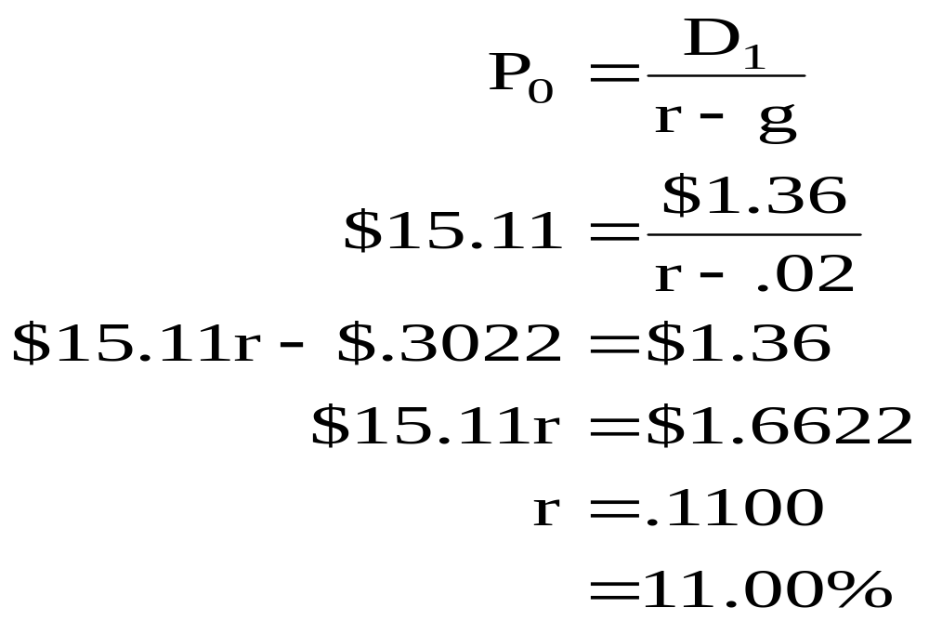
15: Constant growth stock

Slide 17
16: Constant growth stock
The Thomas Co. is in a declining industry and has just announced that they will be reducing their annual dividend by 2% annually from now on. The last dividend they paid was $1.60. The market rate of return on this stock is 6%.
What is the market price of one share of Thomas Co. stock?

Slide 18
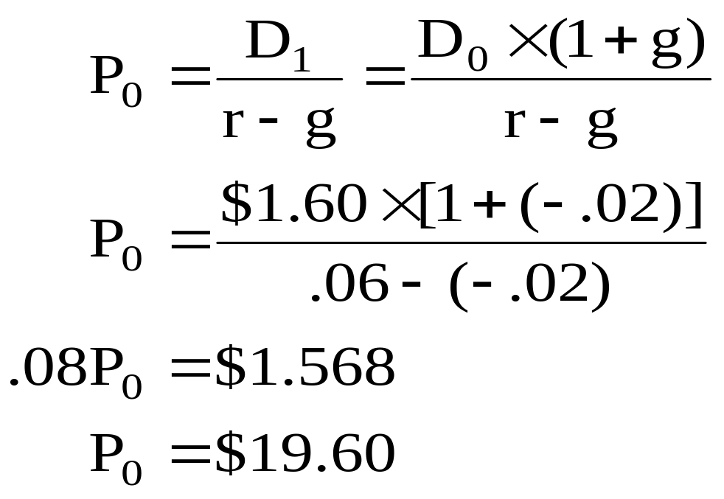
17: Constant growth stock

Slide 19
18: Irregular growth stock
Isaac’s Shoes just announced that they will commence paying annual dividends next year. The plan is to pay $.50, $.75 and $1.00 per share over the next three years, respectively. After that the company plans on increasing the dividend by 2.5% annually. The market rate of return on this stock is 12.5%.
What should the market price of this stock be?

Slide 20
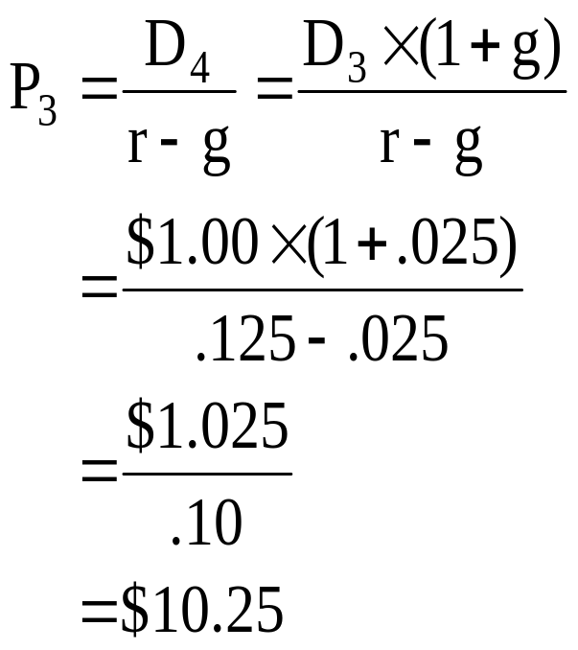
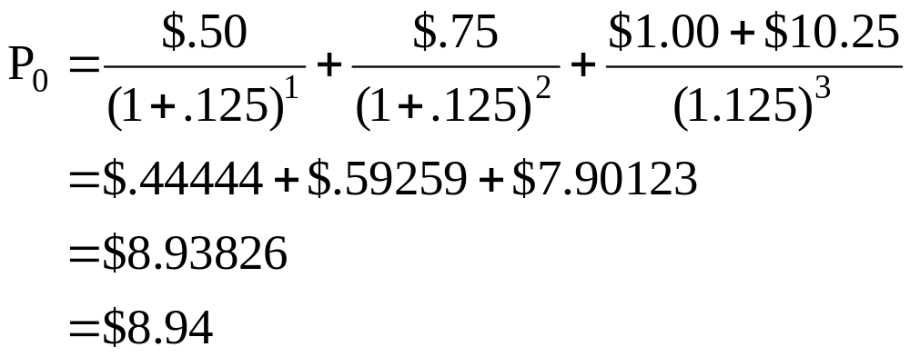
19: Irregular growth stock

Slide 21
20: Irregular growth stock
Nu-Tek, Inc. just paid their annual dividend of $1.20 per share. The company has stated that dividends will increase by 20% a year for the next two years. After that, the dividends will increase by 4% annually.
What is one share of this stock worth today if the required return is 14%?

Slide 22
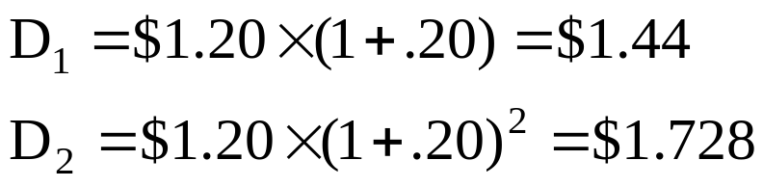
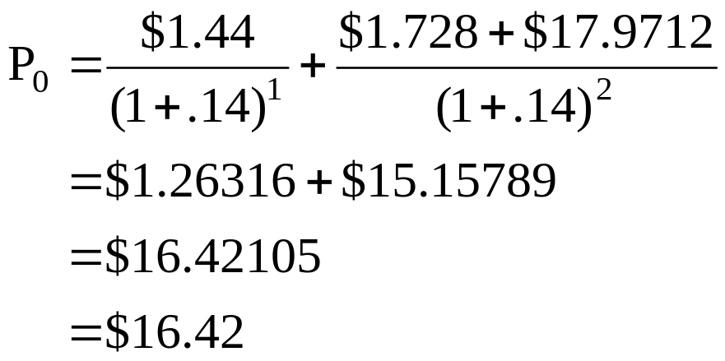
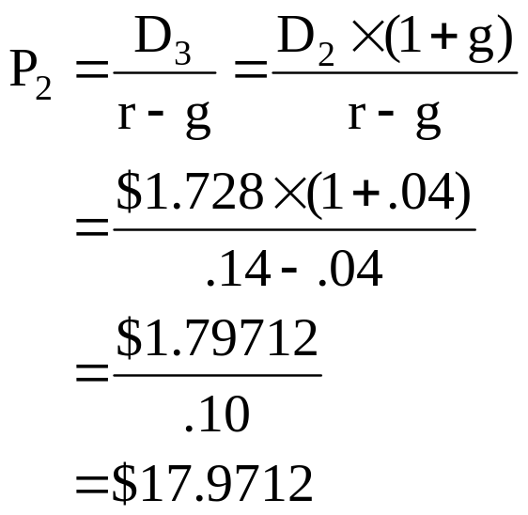
21: Irregular growth stock

Slide 23
22: Irregular growth stock
RPJ, Inc. is currently reinvesting all of their earnings back into the company. They predict that they will pay their first annual dividend five years from now in the amount of $1.00 per share. After that, they will increase the dividends by 2% annually.
How much are you willing to pay for one share of this stock today if you require a 15% rate of return?

Slide 24
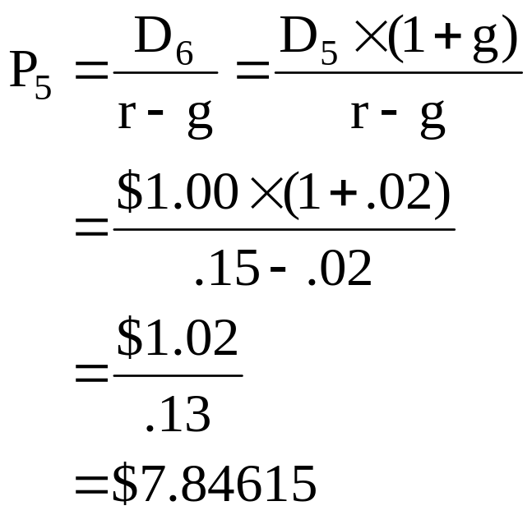
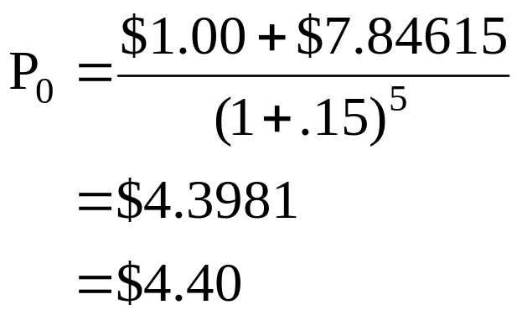
23: Irregular growth stock

Slide 25
24: Required return
The common stock of Flo’s Home Furnishings has a 3.5% dividend yield. You expect the company to grow by 6% annually.
What is the required return on this stock?

Slide 26
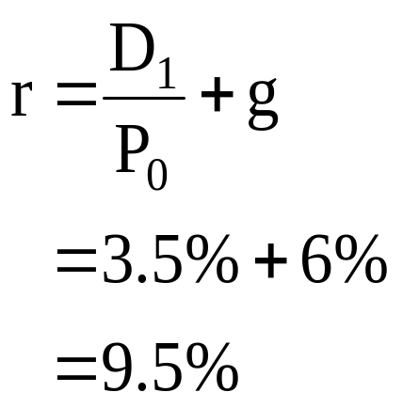
25: Required return

Slide 27
26: Required return
The common stock of Roy’s Outdoor Sports Store has a market rate of return of 17.5% and a market price of $15.00 per share. Roy’s will pay their annual dividend next week in the amount of $2.10 per share.
What is the capital gains yield on this stock?

Slide 28
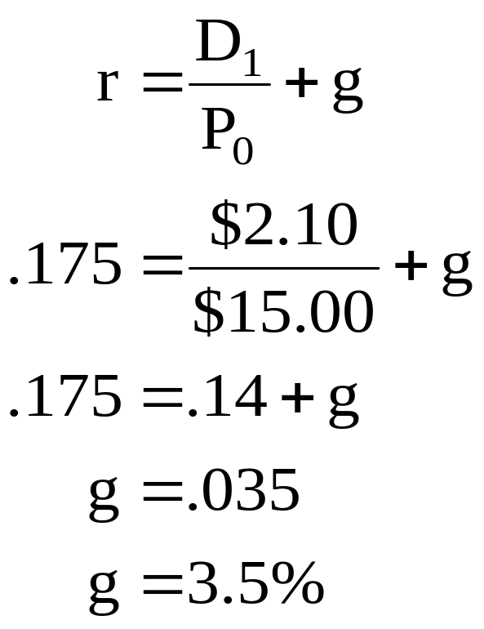
27: Required return

Slide 29
28: Required return
The common stock of Viola’s Flowers, Inc. has a required return of 12.25% and a growth rate of 8%. The stock has a current market price of $32.94 a share.
What is the amount of the next annual dividend?

Slide 30
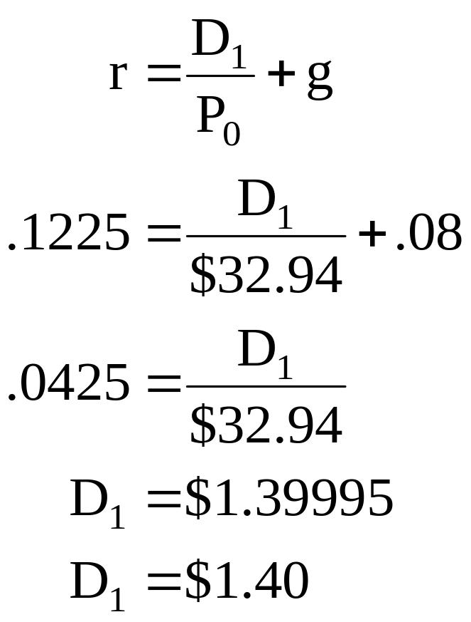
29: Required return

Slide 31
30: Preferred stock
The 7% preferred stock of Lamey, Inc. is priced to yield a 12.5% rate of return.
What is the market price of this stock?

Slide 32
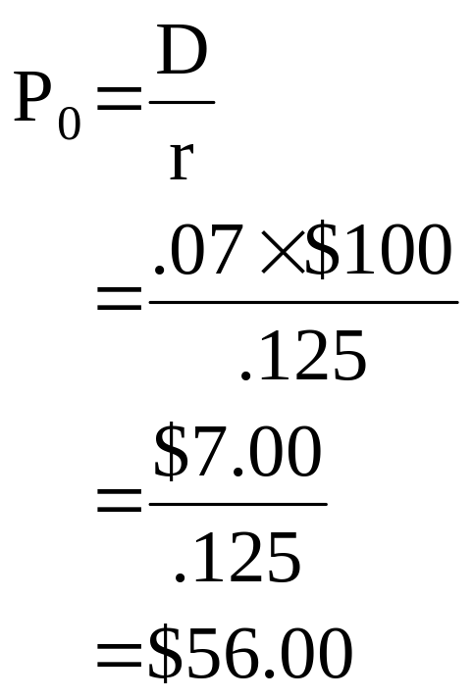
31: Preferred stock

Slide 33
32: Preferred stock
The 9% preferred stock of Eglon, Inc. is selling at a market price of $72.00 a share.
What is the market rate of return on this stock?

Slide 34
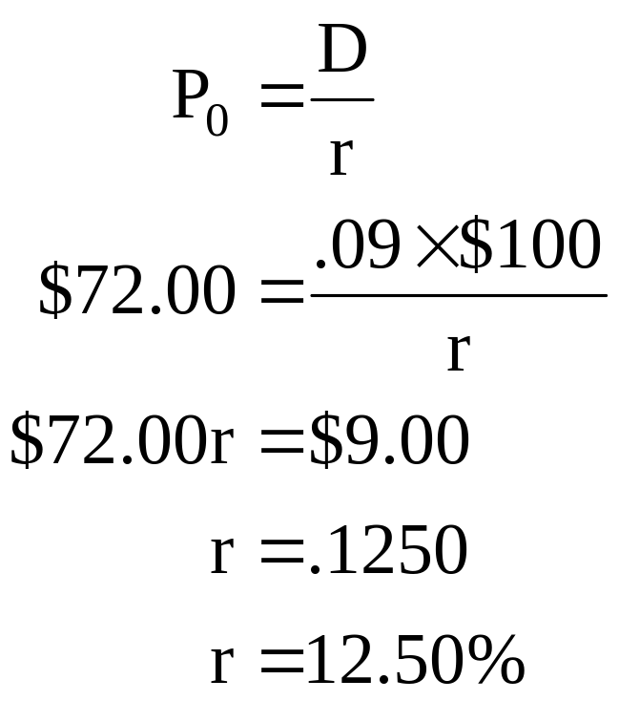
33: Preferred stock

Slide 35
34: Preferred stock
The preferred stock of the P ‘n T Co. is selling for $67.26 a share and provides an 8.55% rate of return.
What is the amount of the preferred dividend per year?

Slide 36
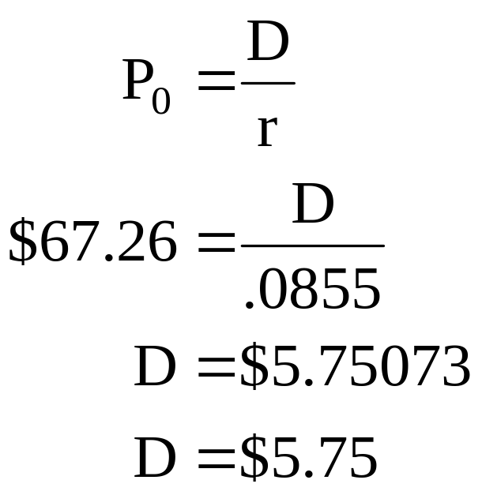
35: Preferred stock

Slide 37
36: Preferred stock
The Oil Town Co. pays dividends on their 6% cumulative preferred stock on an annual basis. The company has not paid this dividend for the last two years. This year the company is doing better financially and wants to pay dividends on both their preferred and their common stock.
What is the minimum amount they must pay per share to their preferred stockholders before distributing any dividends to their common stockholders?
Would your answer differ if the preferred stock was non-cumulative?

Slide 38
37: Preferred stock
Annual dividend = .06 × $100 = $6.00
Minimum due per share to the preferred stockholders:
Cumulative:
$6 + $6 + $6 = $18
Non-cumulative:
$6

Slide 39
38: Shareholder voting
WV & BK, Inc. has 125,000 shares of common stock outstanding. The company currently has 2 open seats on their board of directors and uses cumulative voting.
How many shares of stock must you own to ensure your election to one of the open positions if you doubt that anyone else will vote for you?

Slide 40
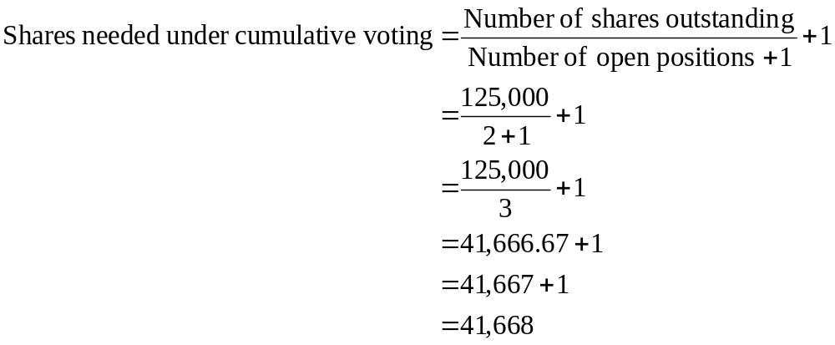
39: Shareholder voting

Slide 41
40: Shareholder voting
Lakeland Industries has 260,000 shares of stock outstanding. The company currently has three open positions on their board of directors. These positions will be filled using straight voting. Currently, you own 85,000 shares of this stock which has a current market price of $21.40 a share.
How much money must you spend to purchase additional shares if you want to absolutely guarantee that you will be elected to one of those three positions? Assume that no one else votes for you.

Slide 42
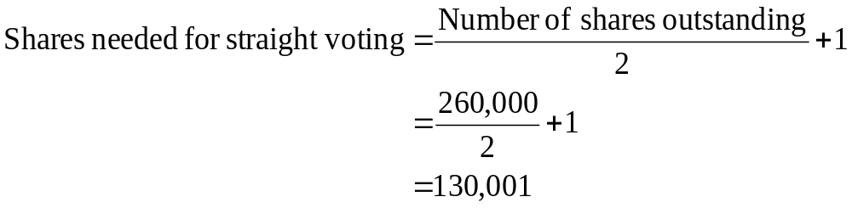
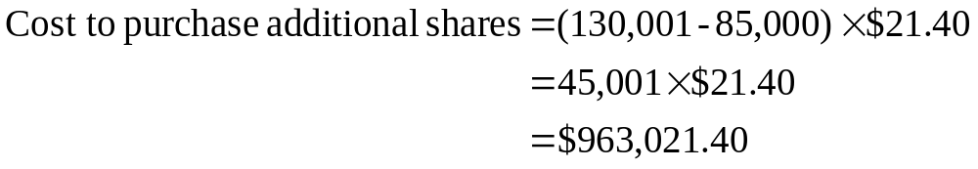
41: Shareholder voting

Slide 43
42: Stock market reporting
ABC Co. stock closed today at a price of $48.24. The price-earnings (P/E) ratio is 18 and the dividend yield is 2.1%.
What is the amount of the earnings per share?
What is the amount of the annual dividend?

Slide 44
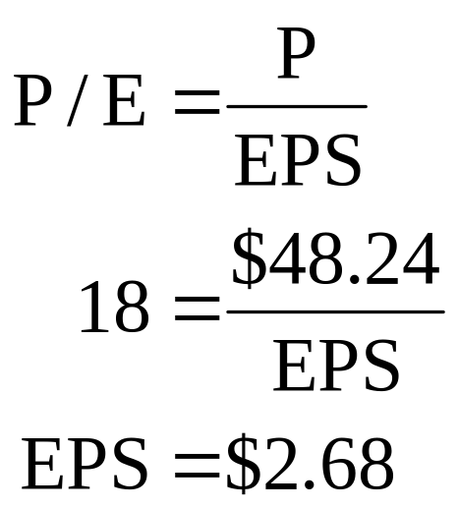
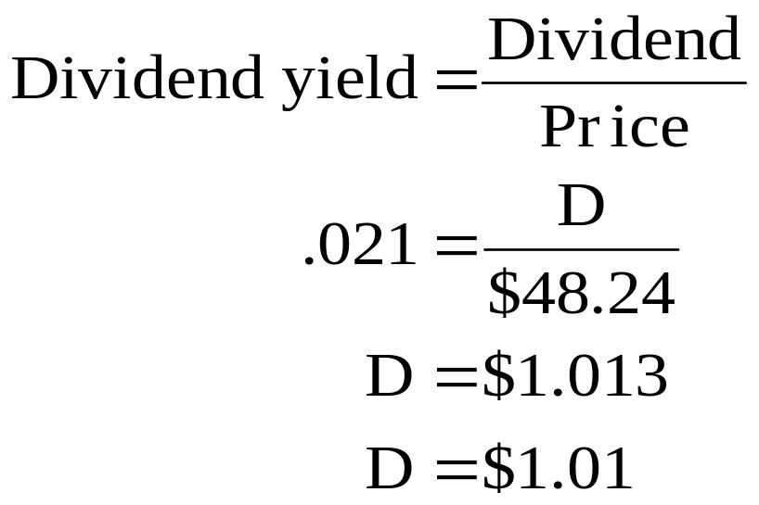
43: Stock market reporting

Slide 45
8
End of Chapter 8

